Slide 1
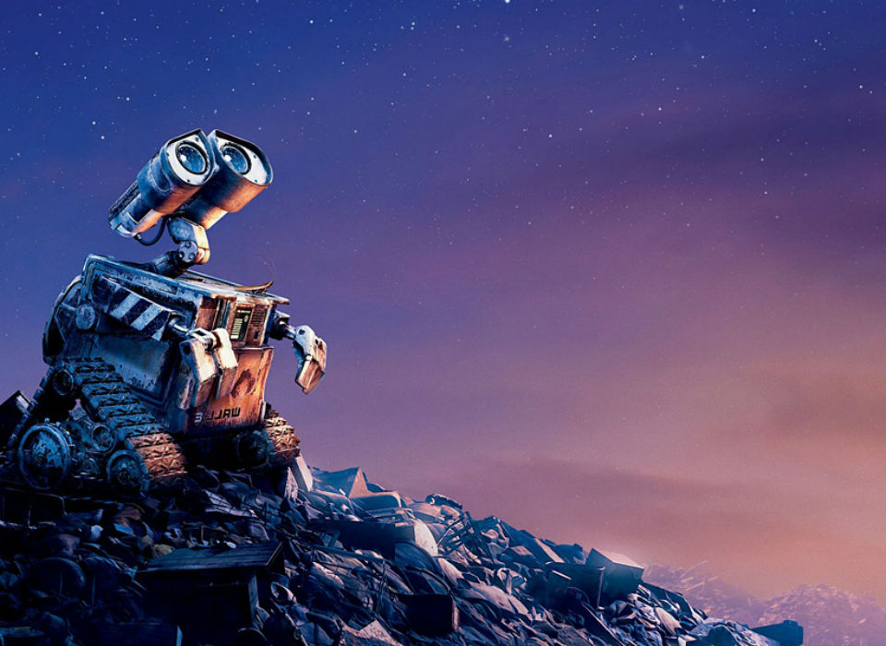

CS106A: Programming Methodologies

Slide 2
Chris Piech
My parents are interesting folks
I originally concentrated in graphics and worked at Pixar
Childhood: Nairobi, Kenya
High School: Kuala Lumpur, Malaysia
Stanford University Ph.D. in Neural Networks
Research lab on AI for Social Good
Researcher in the MSR cognitive science lab
The problem I really want to solve is to make high quality more education accessible

Slide 3
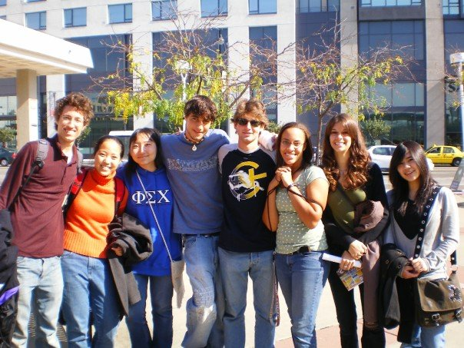
Chris Piech
10 years ago to this day, I was sitting in your seats

Slide 4
Head TA: Nick Troccoli

Slide 5
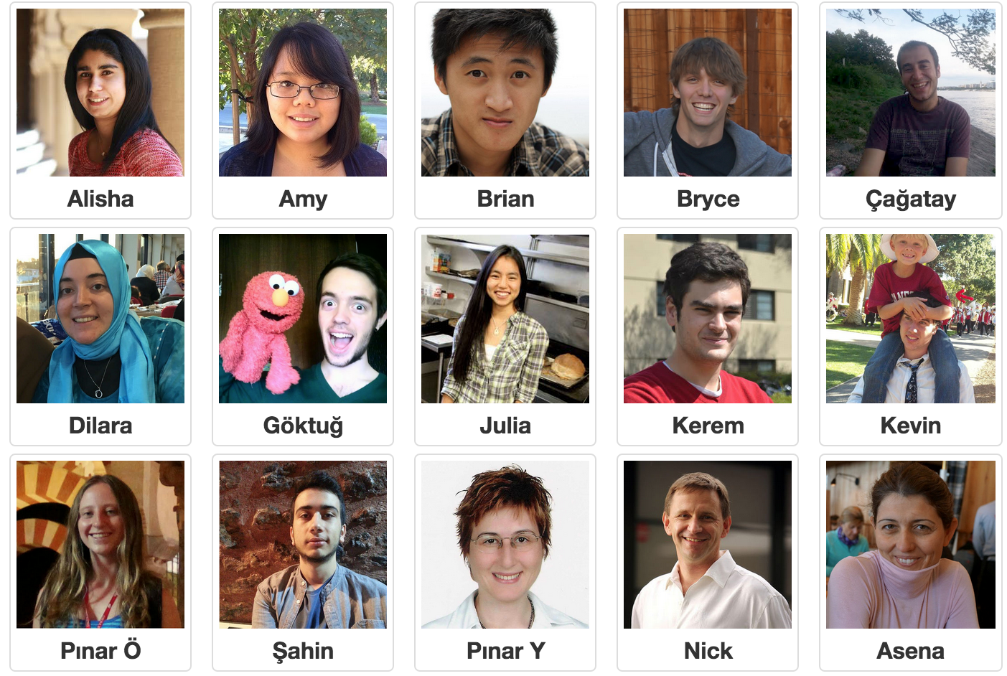
Section Leaders

Slide 6
Who are you?

Slide 7


Prerequisite Test
Notes:
Just need to know how to turn on a computer.
In fact about 7 years ago I was in your seats learning programming.
… and then I did the grad school thing and the teaching thing.
It worked out.

Slide 8
Are you in the right place?

Slide 9
Course mechanics
(this is a light version. Please read the handout for details).

Slide 10
Course Website
http://cs106a.stanford.edu

Slide 11
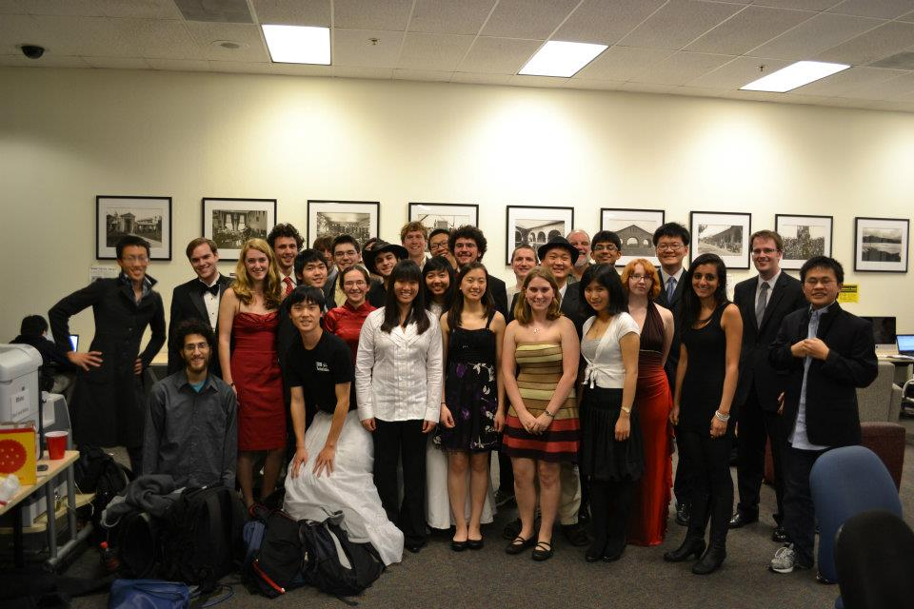
Lectures and Sections
Weekly 50-min section led by awesome section leaders (the backbone of the class!)
Signups begin on Thursday at 5:00pm and close Sunday at 5:00pm
Pair programming with others in your section.

Slide 12
Office Hours
LaIR: 6pm until midnight Sunday through Thursday (starting next Sunday)

Slide 13


Grading Scale
Functionality and style grades for the assignments use the following scale:
A submission so good it “makes you weep.”
Exceeds requirements.
Satisfies all requirements of the assignment.
Meets most requirements, but with some problems.
Has more serious problems.
Is even worse than that.
Better than nothing.

Slide 14
What we will ask you to do
*Two free late days

Slide 15
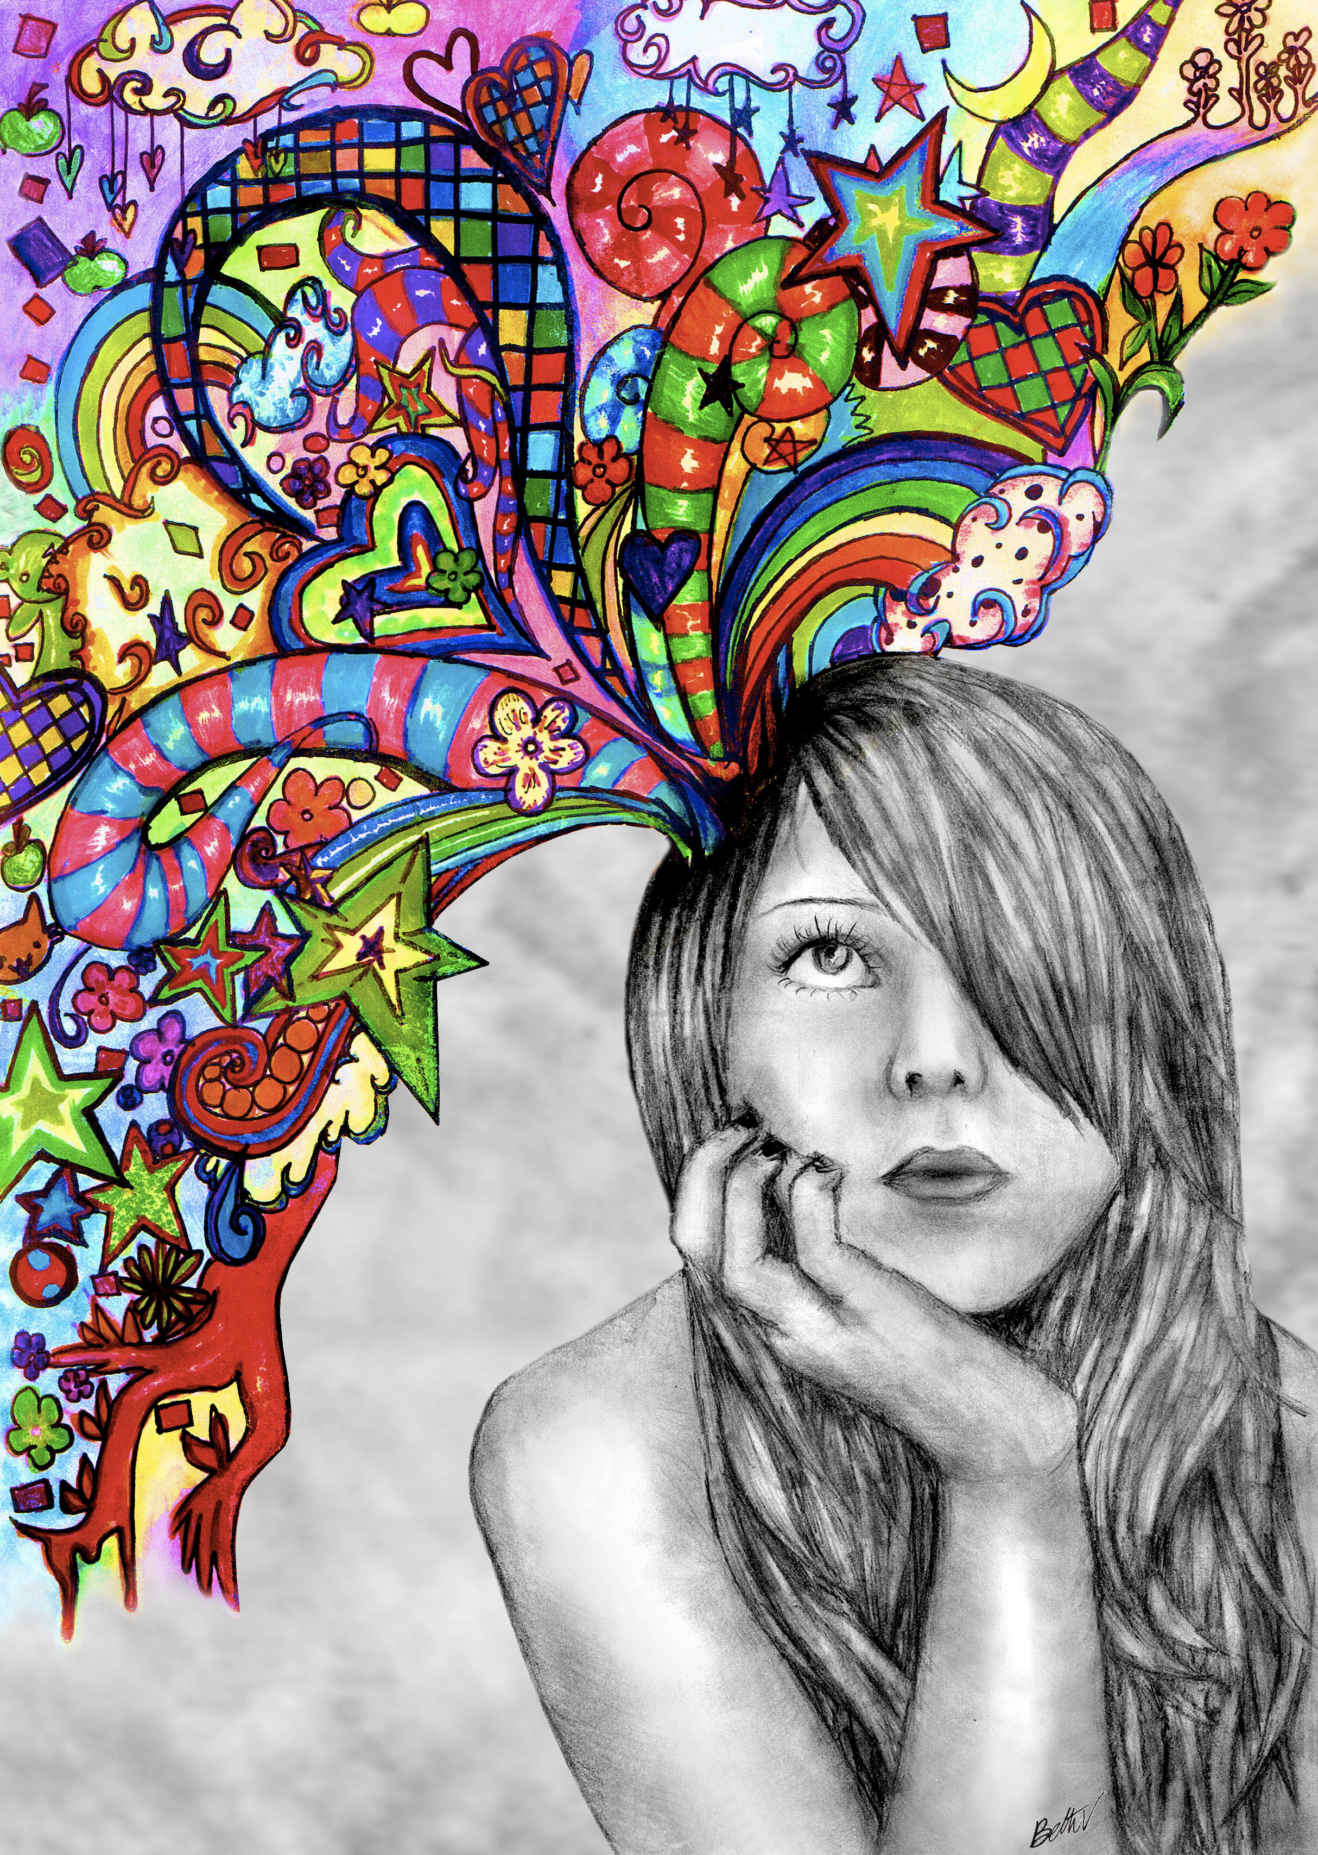
Optional Contest

Slide 16

Textbook
The Art & Science of Java by Eric Roberts
written here at Stanford
tailored to this course
a valuable reference
usable on open-book exams
Karel the Robot Learns Java
First week of material

Slide 17
CS106A Units
Start Here
Average about 10 hours / week for assignments
Are you an
undergrad or
SCPD
student?
Do you want
to take CS106A for
fewer units?
No
Yes
3 Units
-or-
4 Units
Yes
No
5 Units

Slide 18
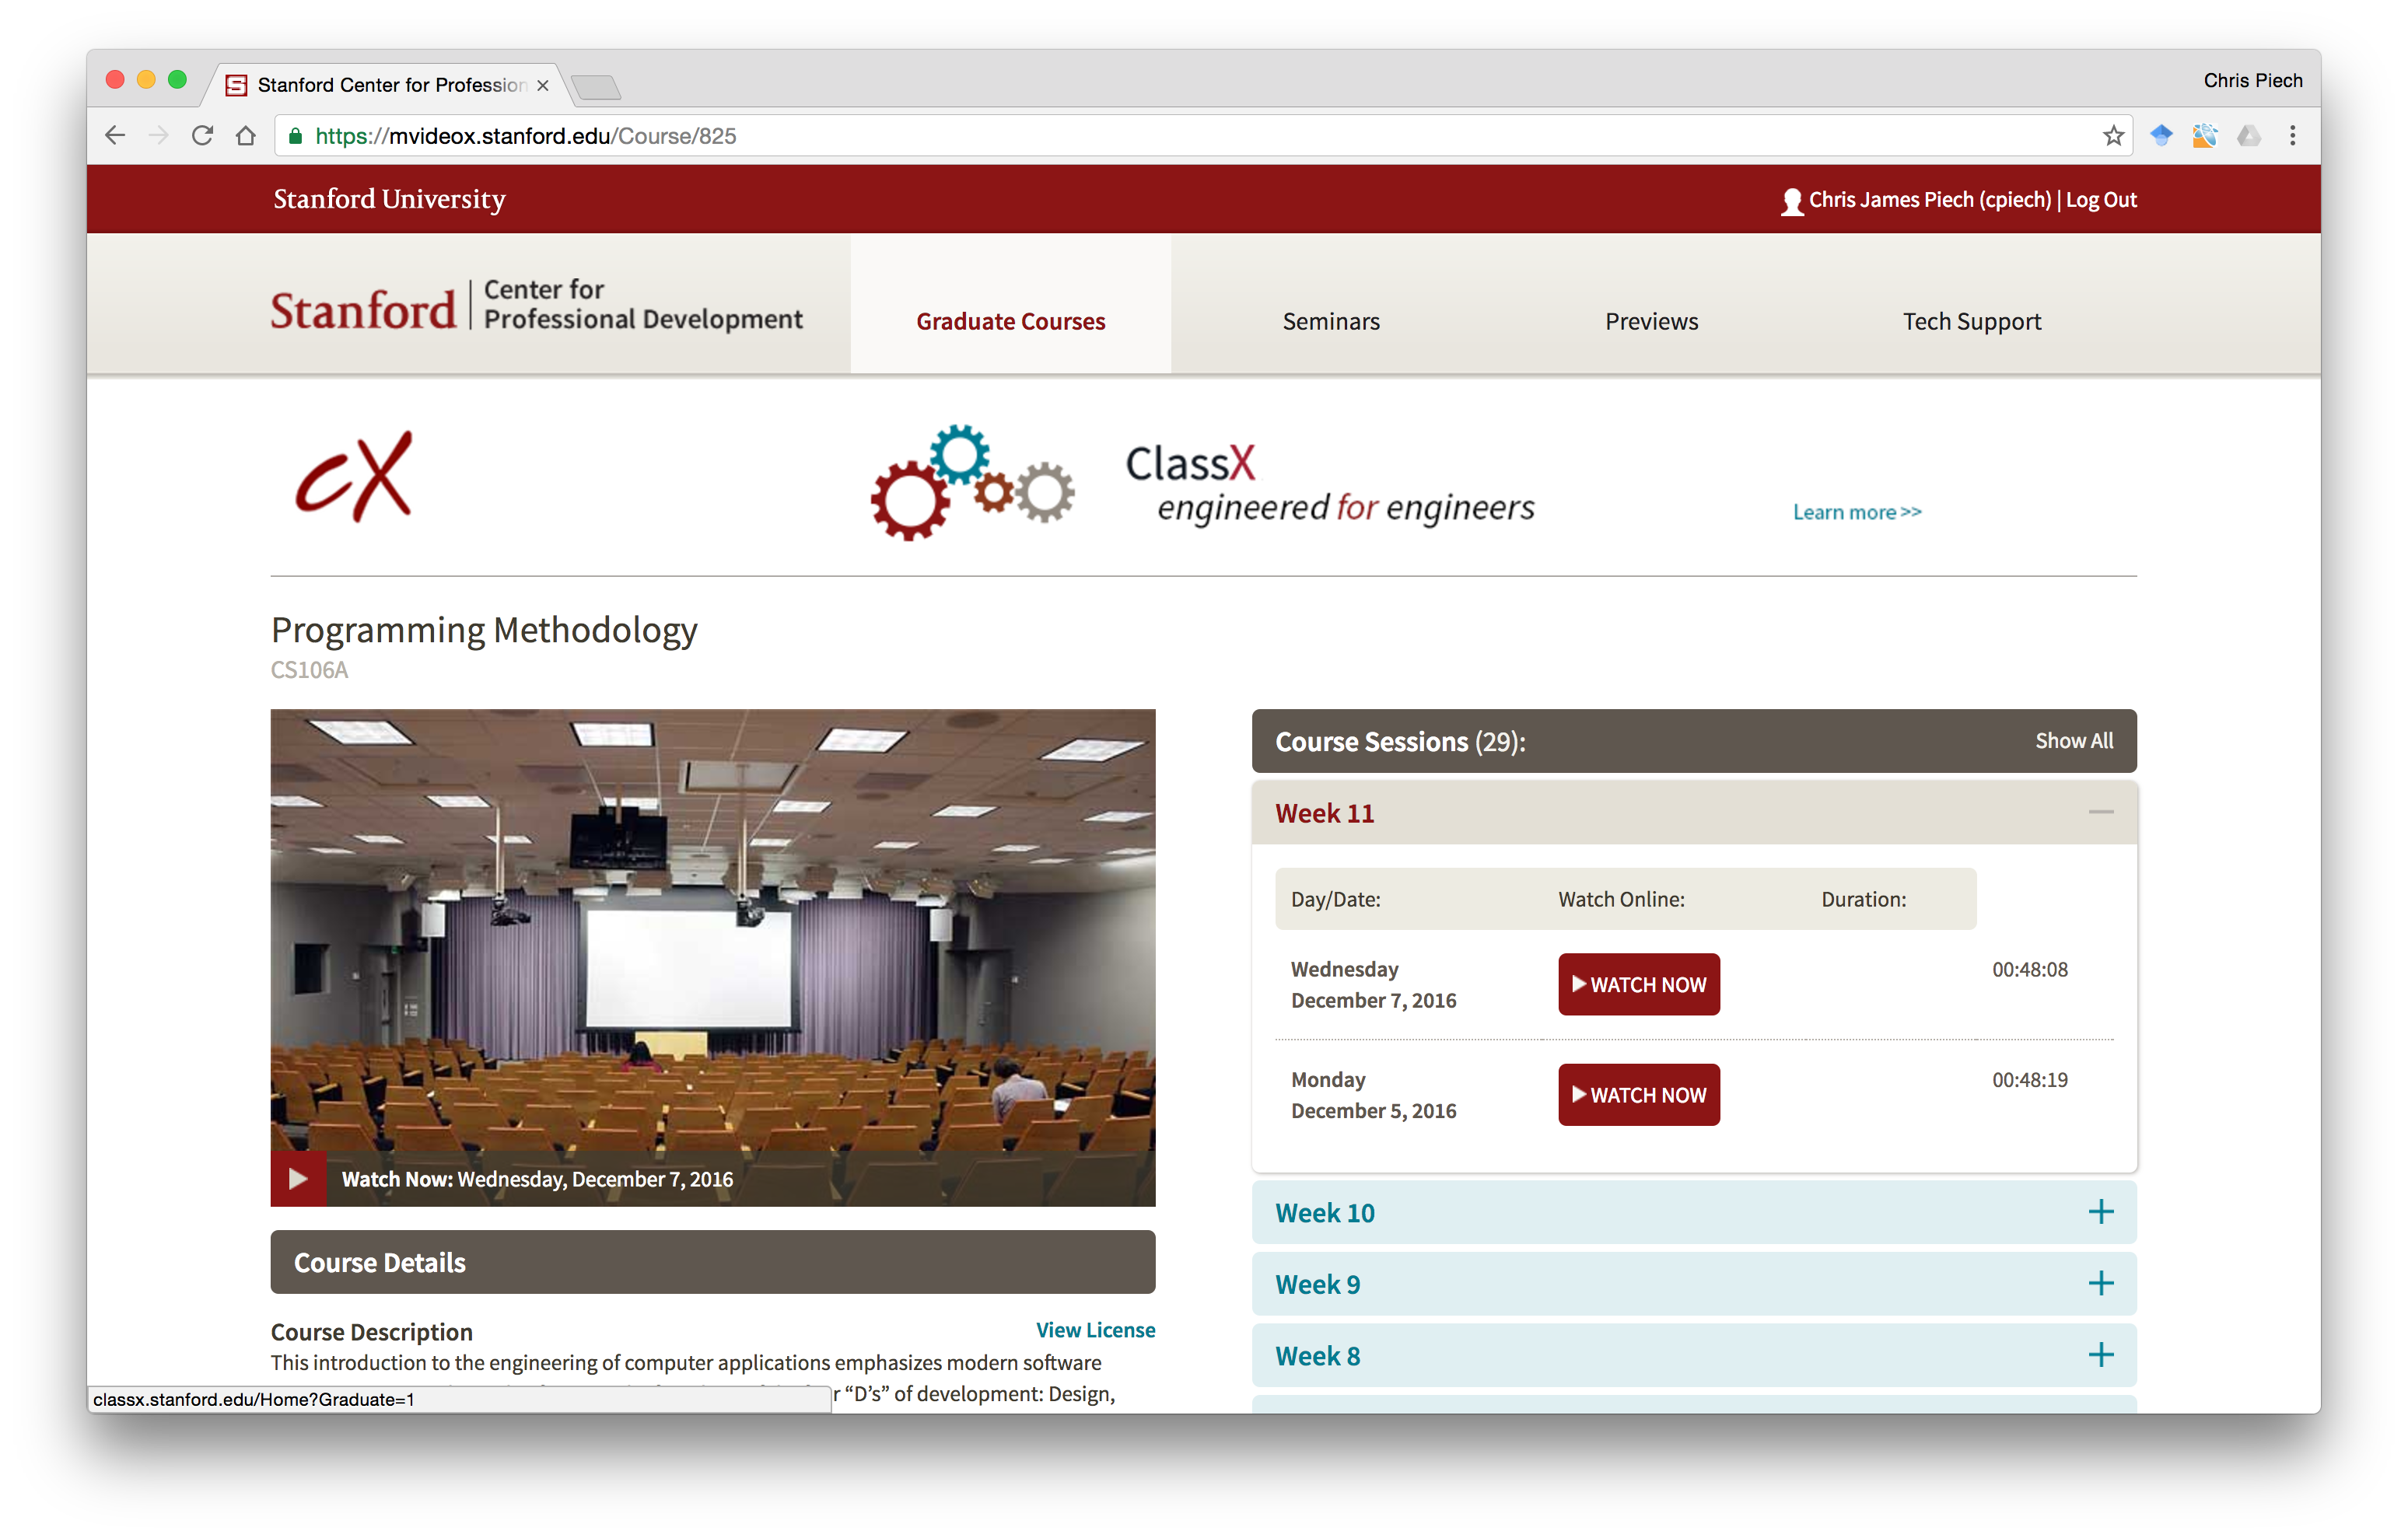
Lectures are Online

Slide 19
What is CS106A?

Slide 20
Computer Science
Computer science is no more about computers than astronomy is about telescopes, biology is about microscopes or chemistry is about beakers and test tubes. Science is not about tools, it is about how we use them and what we find out when we do.
- Michael Fellows and Ian Parberry

Slide 21
Learning Goals
Learn how to harness computing power to solve problems.
To that end:
Explore fundamental techniques in computer programming.
Develop good software engineering techniques.
Gain familiarity with the Java programming language.

Slide 22
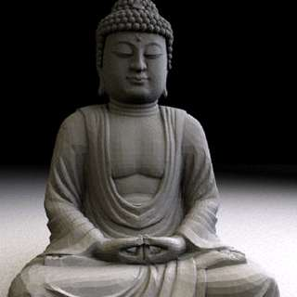
Art of Computer Science
Notes:
We teach software engineering principles. Much larger than just programming.
Mechanics of the language are nothing compared to the principles.
You are going to learn the principles by programming in Java

Slide 23
There are a lot of cool programs you may one day write

Slide 24
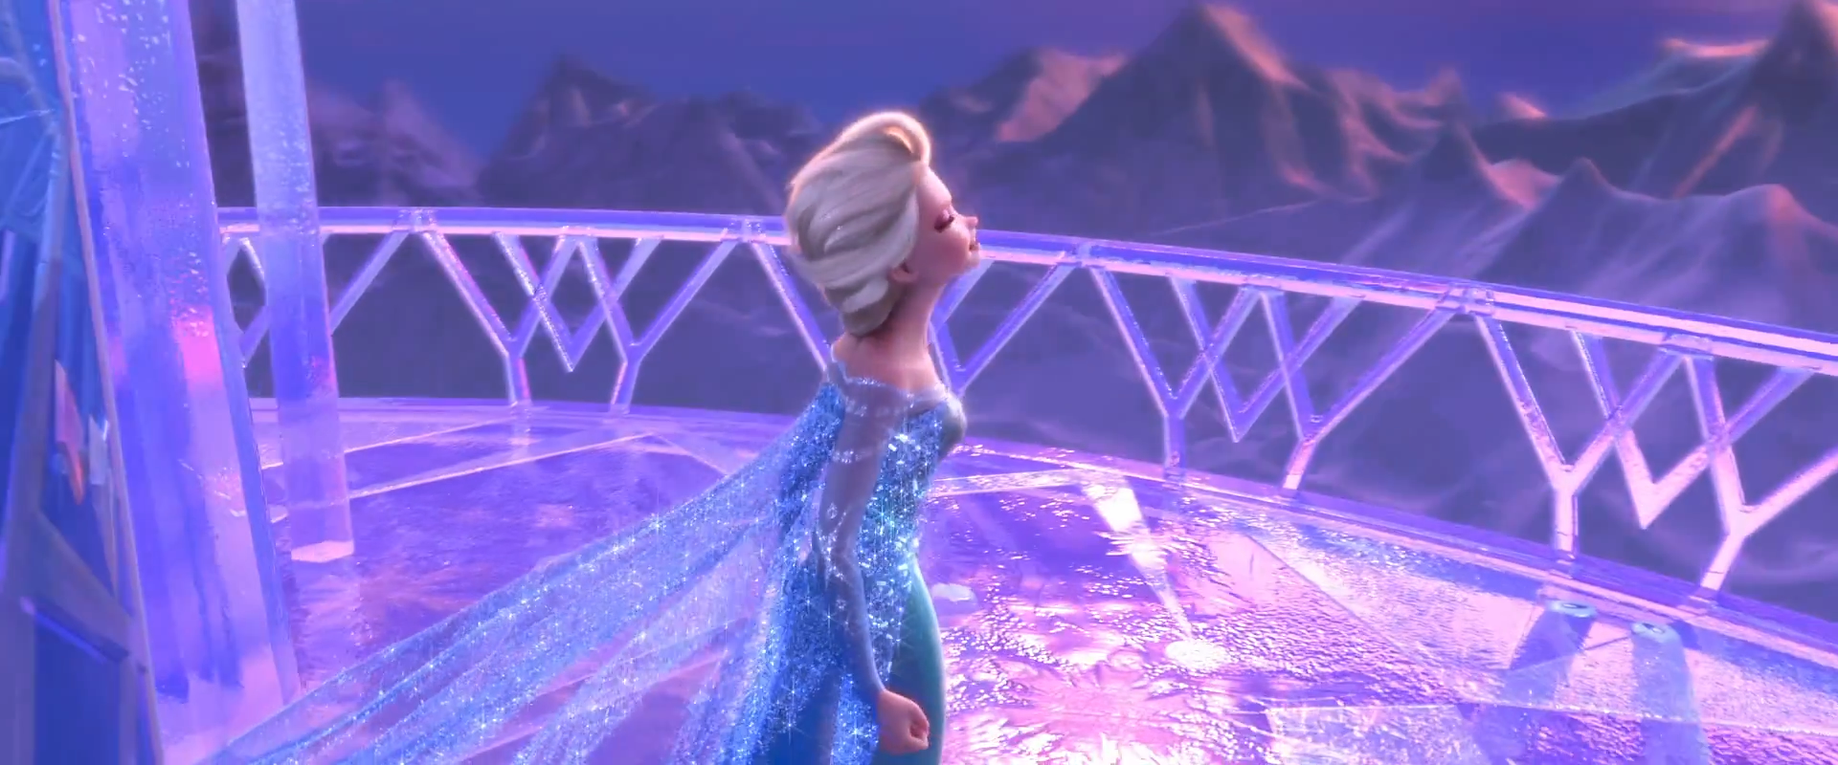
Computer Graphics
Pat Hanrahan, one of the founders of Pixar is a professor here

Slide 25
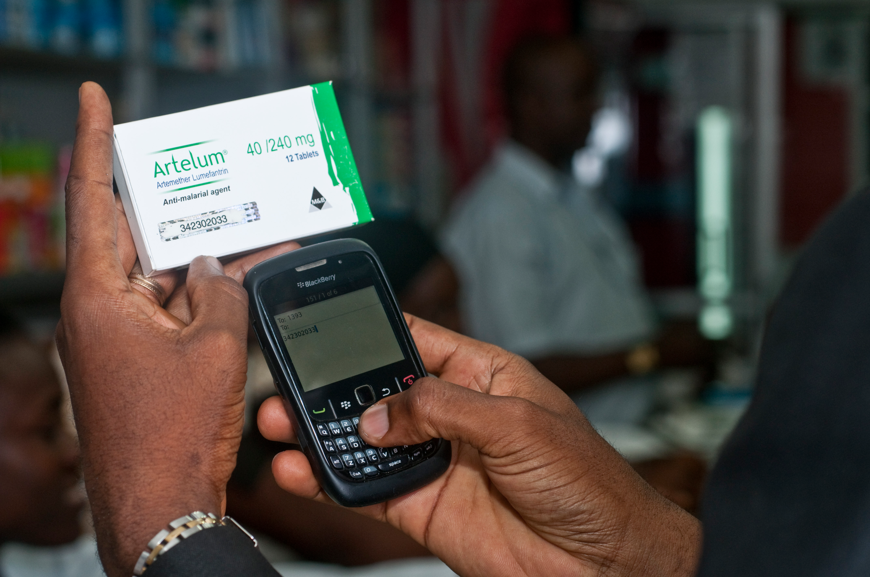
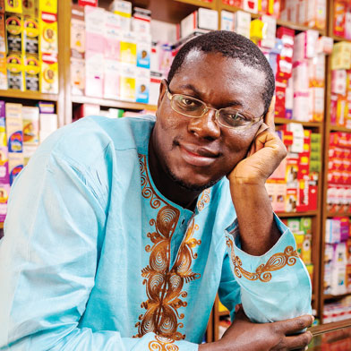
Consumer Applications
Notes:
Estimated 700,000 deaths from fame malaria and TB drugs in 2013:
http://www.un.org/africarenewal/magazine/may-2013/counterfeit-drugs-raise-africa%E2%80%99s-temperature
Bright Simmons from Ghana made an application which let people verify if their medication was authentic

Slide 26
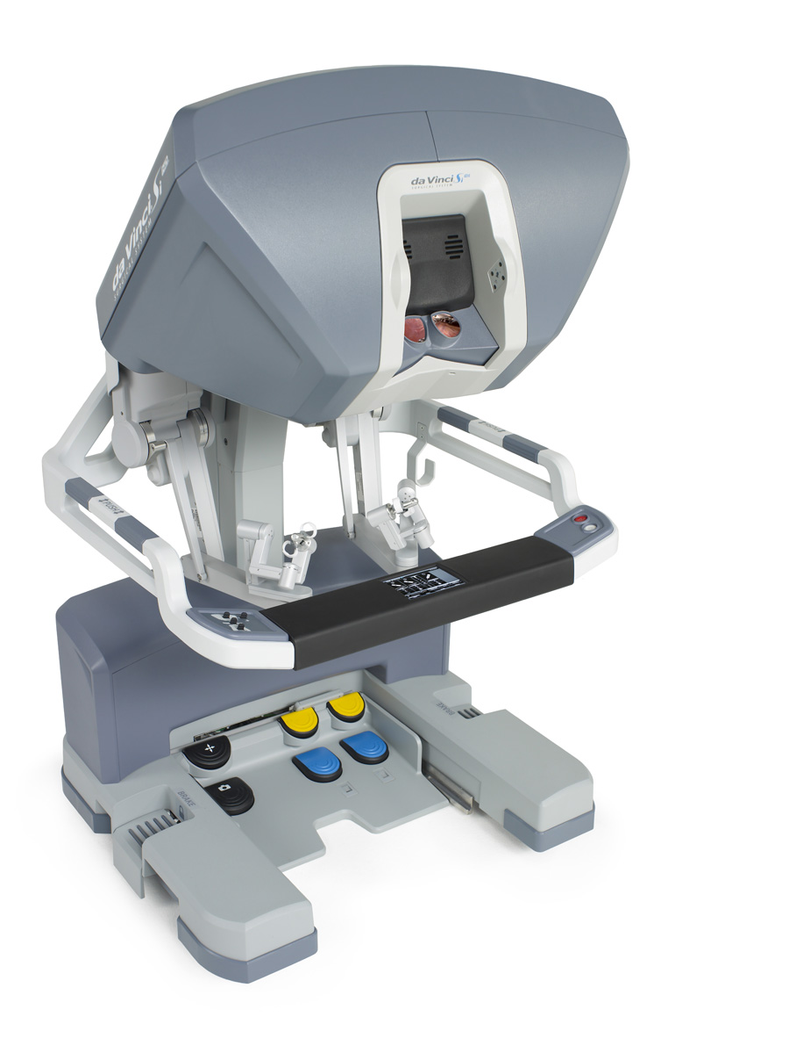
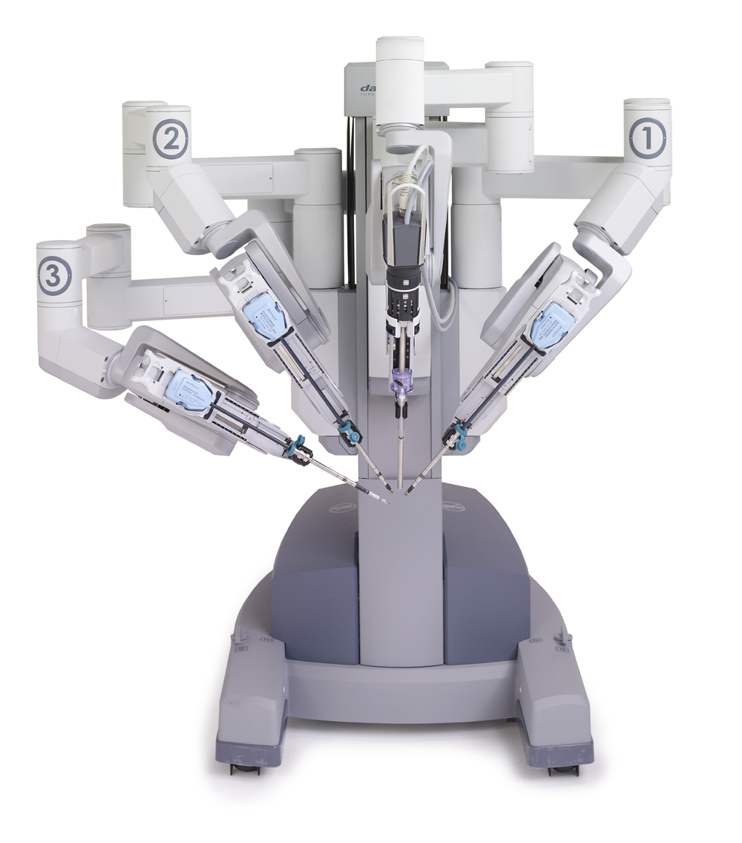
Autonomous Surgery
(c) 2012 Intuitive Surgical, Inc.

Slide 27
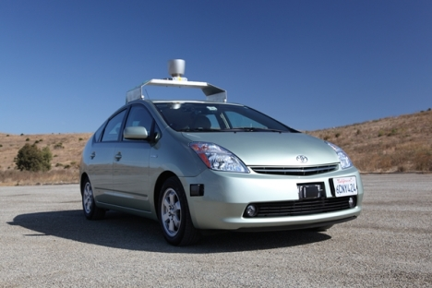
Self Driving Car

Slide 28
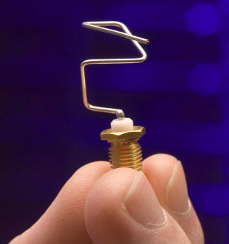
Genetic Algorithms
http://www.nasa.gov/centers/ames/images/content/144975main_ACD06-0043-007.jpg

Slide 29
If only we could program self driving cars…

Slide 30
Graphical Games

Slide 31
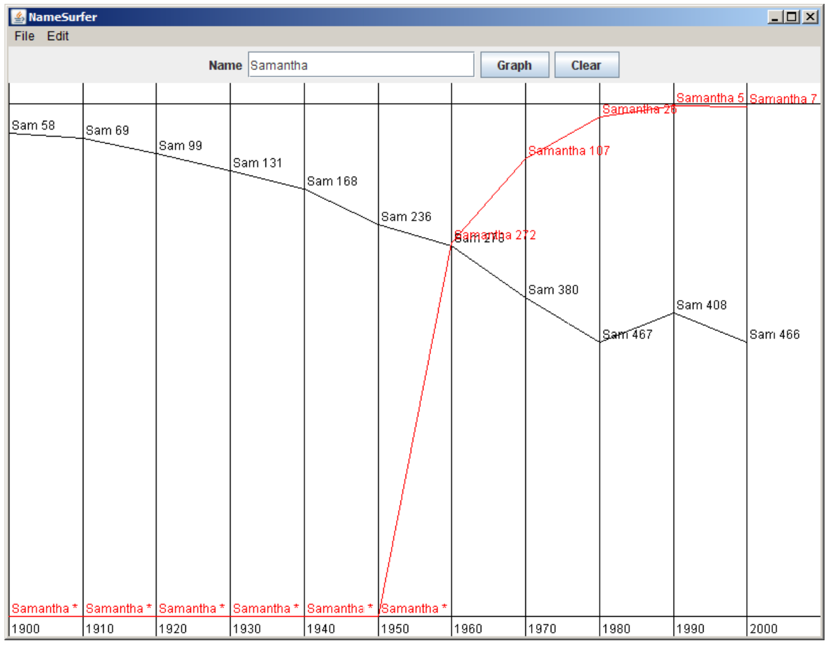
Data Visualization

Slide 32
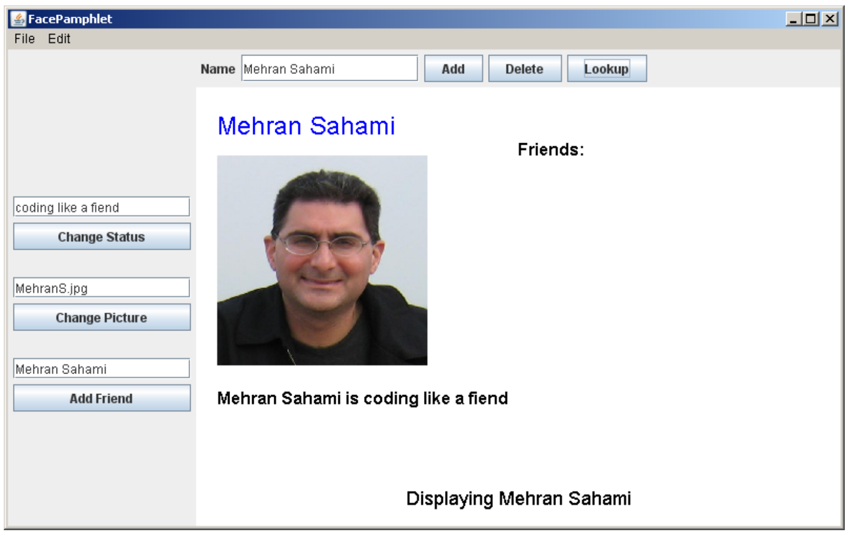
Mini Facebook

Slide 33
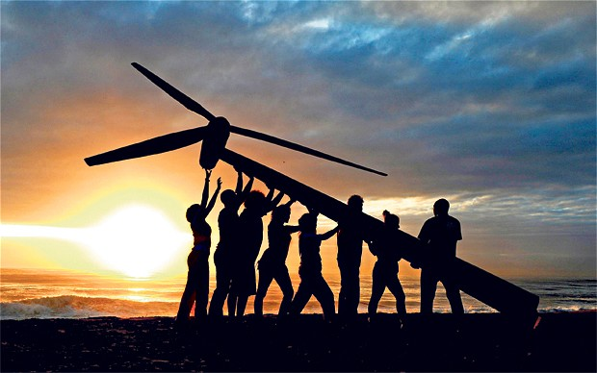
Strive for Everyone to Succeed
Notes:
We want all of you to be successful
That’s why we have such a large course staff
And its not like it’s a ya-ya course where we all hold hands and sing koombaya. Its real material.
But over years and years and years we have been working on our material so that everyone gets through…
Not competing against anyone but yourself

Slide 34
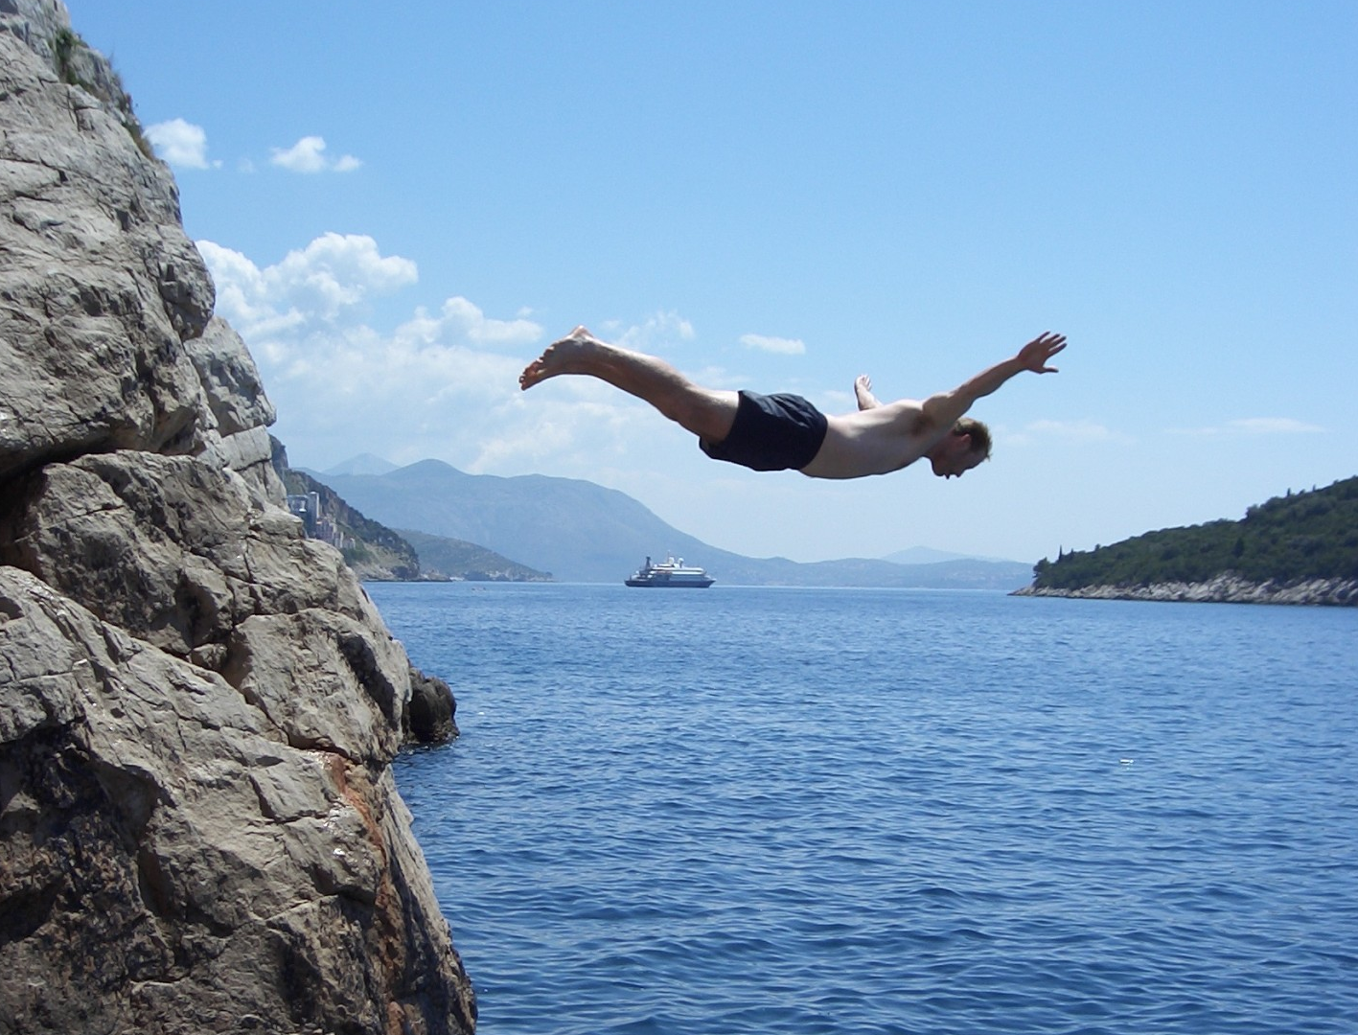
Lets Get Started

Slide 35
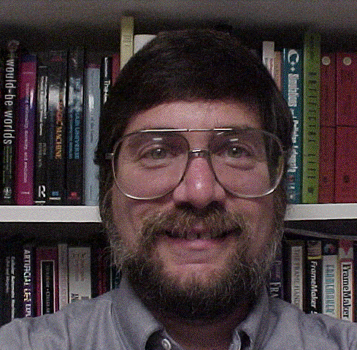

Meet Karel the Robot
Good morning
Notes:
He looks like an old machintosh machine.
Hes got legs… one sticks out the back. That’s just the way it is.

Slide 36

Karel Speaks Java
s
Notes:
Tomorrow you will learn that Karel is actually a very gentle introduction to programming

Slide 37

Karel’s World
North
3
+
+
+
+
+
2
+
+
+
+
+
West
East
1
+
+
+
+
+
South
1
2
3
4
5
Notes:
To you it might not be exciting but to karel its very exciting.

Slide 38

Walls
3
+
+
+
+
2
+
+
+
+
1
+
+
+
+
1
2
3
4

Slide 39

Beepers
3
+
+
+
+
2
+
+
+
+
1
+
+
+
+
1
2
3
4

Slide 40
Knows Four Commands
move();
turnLeft();
putBeeper();
pickBeeper();
Notes:
Tomorrow you will learn that Karel is actually a very gentle introduction to programming

Slide 41
move();

Slide 42

move();
3
+
+
+
+
2
+
+
+
+
1
+
+
+
+
1
2
3
4

Slide 43
move();
3
+
+
+
+
2
+
+
+
+
1
+
+
+
+
+
1
2
3
4

Slide 44
turnLeft();

Slide 45
turnLeft();
3
+
+
+
+
2
+
+
+
+
1
+
+
+
+
+
1
2
3
4

Slide 46
turnLeft();
3
+
+
+
+
2
+
+
+
+
1
+
+
+
+
+
1
2
3
4

Slide 47
pickBeeper();

Slide 48
pickBeeper();
3
+
+
+
+
2
+
+
+
+
1
+
+
+
+
+
1
2
3
4

Slide 49
pickBeeper();
3
+
+
+
+
2
+
+
+
+
1
+
+
+
+
+
1
2
3
4

Slide 50
Make Sense?

Slide 51
First Challenge
3
+
+
+
+
2
+
+
+
+
1
+
+
+
+
1
2
3
4

Slide 52
First Challenge
3
+
+
+
+
2
+
+
+
+
1
+
+
+
+
1
2
3
4

Slide 53
Bird’s Eye View
3
+
+
+
+
2
+
+
+
+
1
+
+
+
+
1
2
3
4
Karel is facing East

Slide 54
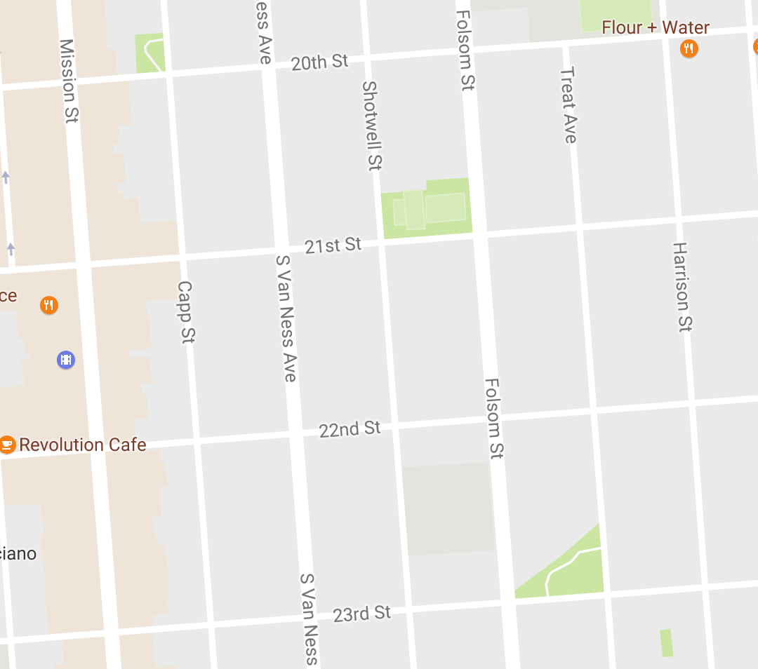
Bird’s Eye View
Karel is facing East

Slide 55
Turn Left
Karel is facing North

Slide 56
Turn Left
Karel is facing West

Slide 57
Turn Left
Karel is facing South

Slide 58
Move

Slide 59


Slide 60
Method Definition
private void name() {
method statements
}
This adds a new command to Karels vocabulary

Slide 61
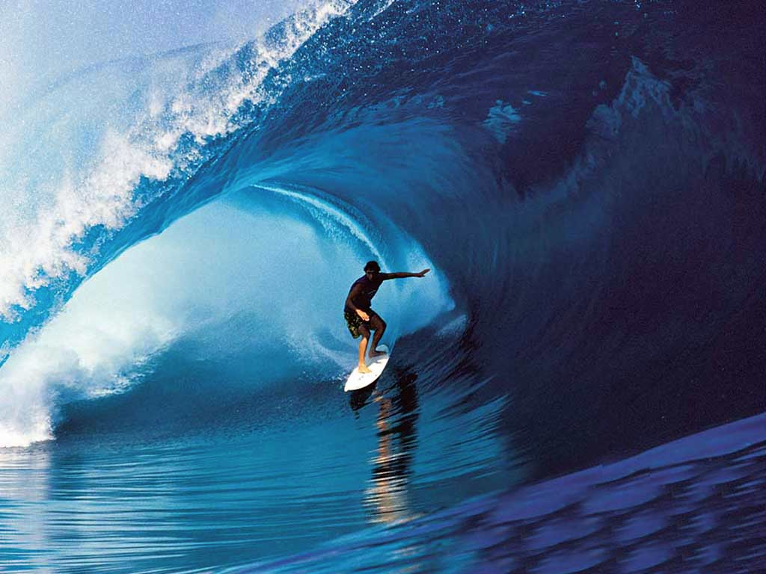
Learn By Doing

Slide 62
Why Study CS?

Slide 63
Joy of Building

Slide 64
Interdisciplinary

Slide 65

Closest Thing To Magic

Slide 66
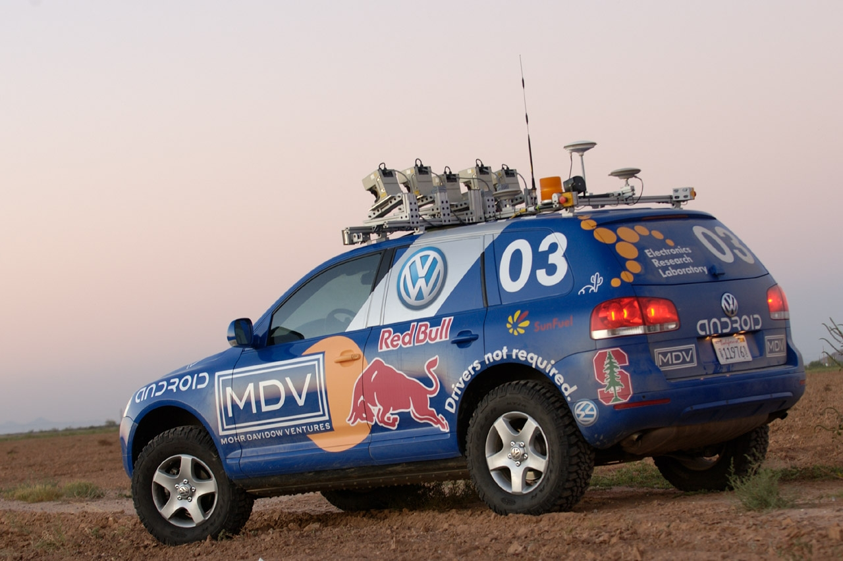

Now is the Time

Slide 67
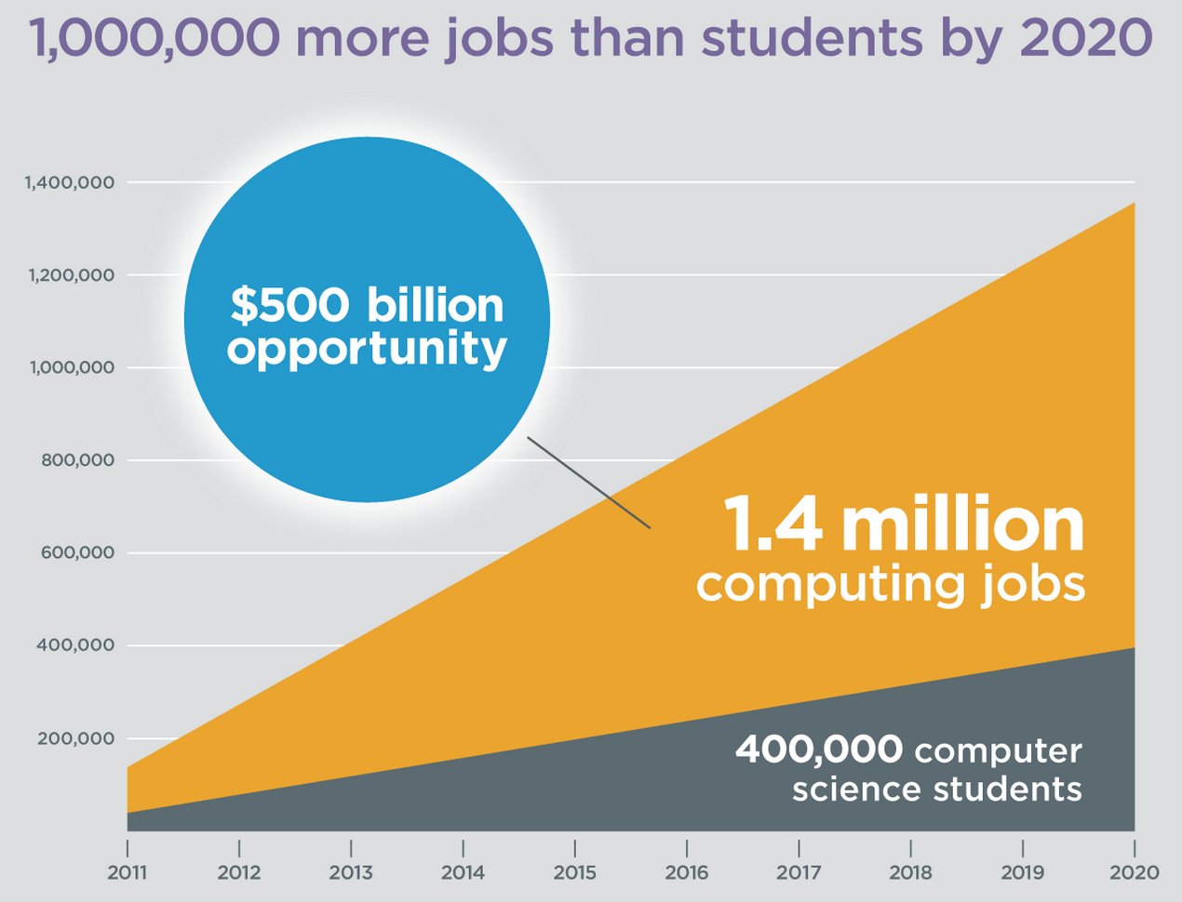
Oh and Its Useful
Code.org

Slide 68
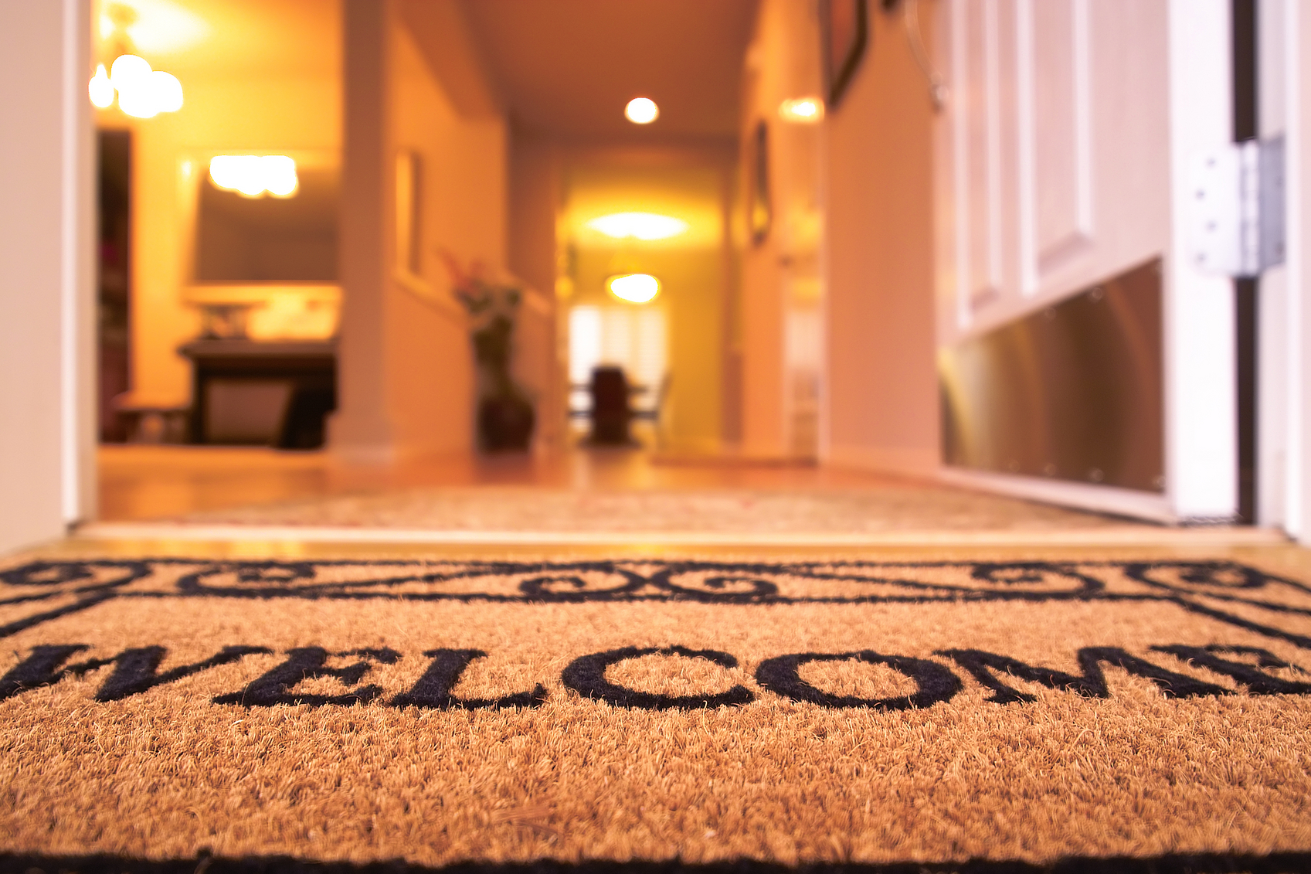
Everyone is Welcome

Slide 69
The End

Slide 70
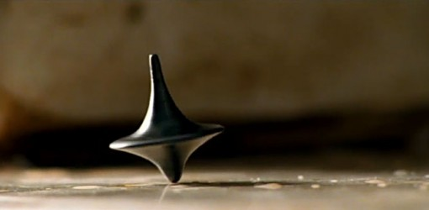
The End?

